Slide 1

Unlocking Customer Behavior for Effective Marketing
Final Project Team Name : Data Enthusiasts Team Members: Amanullah (Leader) & Daniyal Hyder Trainer: Miss Reema Memon Date: 15/11/2024

Slide 2

Project Background
1
Digital-First World
E-commerce and physical stores rely on digital marketing to connect with customers.
2
A Project that leverage our skills
We brain storm so long about such project that come up with this
3
Project Goals
Identify key areas of confusion and provide solutions for marketers.

Slide 3

Problem Statement
The goal of this Project is to understand customer behavior and evaluate the effectiveness of various marketing strategies. Specifically, we aim to predict customer conversion based on various factors such as demographics, campaign performance, and engagement metrics. To address this, we approached the problem through five (5) key questions mentioned below with their answers, applying different techniques and models to answer them
.
Dataset
Comprehensive data integrating engagement, demographic, and campaign metrics from Kaggle.

Slide 4
Data Preparation and Pre-processing
Data Wrangling
Handling Missing Values
Duplicate rows
Standardized and normalized data for consistency across all columns.
No missing values found in the dataset.
No duplicate rows found in dataset
Outliers
Feature Encode
Feature Engineering
No outliers, IQR method used to identify
Gender column encoded where 0 represents “Male” and 1 “Female”
Combined features to create total_page_views and email_engagement.

Slide 5
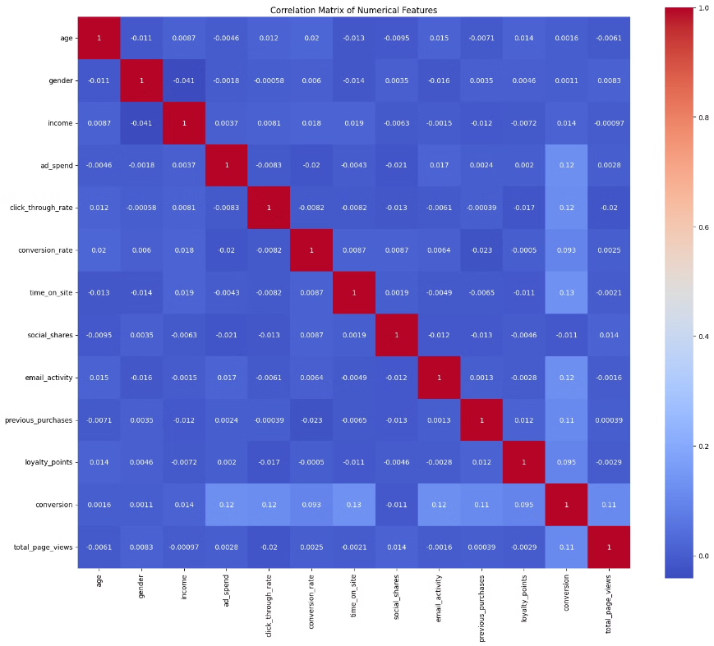
Exploring Relationships Between Columns
Correlation analysis revealed weak correlations between numerical features, indicating non-linear relationships. This suggests that complex models may be needed to capture underlying patterns effectively.

Slide 6
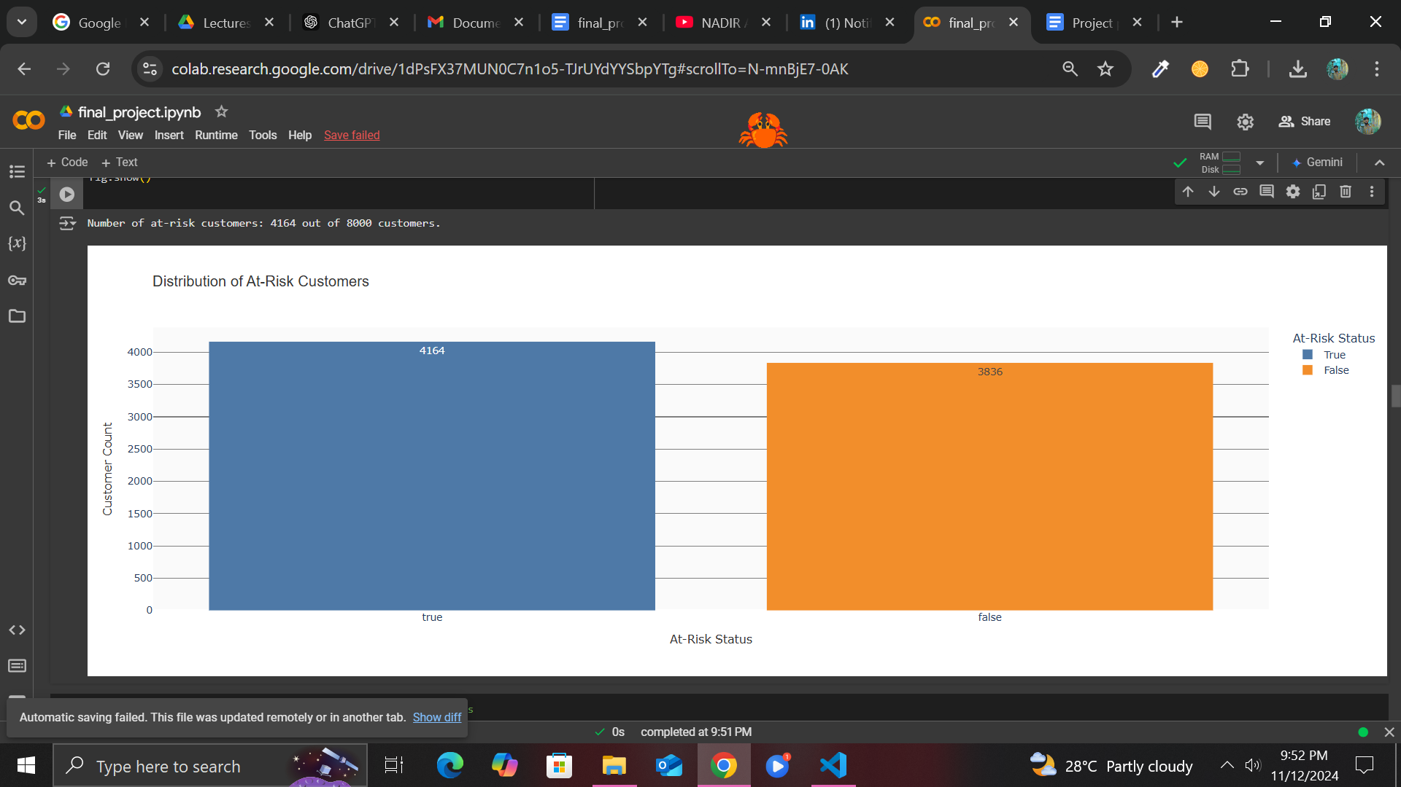
Problem: Which customers are at risk of leaving (not making future purchases) based on their engagement data and loyalty points?
At-Risk Customers
4,164 out of 8,000 customers are at risk of not making future purchases.

Slide 7

Hypothesis Testing
Problem 2: Conduct hypothesis testing to evaluate the effectiveness of Social Media and PPC (Pay-Per-Click) marketing campaigns. The goal is to determine if the conversion rates of both channels are equal, assessing whether they drive conversions equally effectively.
Mean Conversion Rate (Social Media): 0.1066
Mean Conversion Rate (PPC): 0.1041
T-Statistic: 1.2402
P-Value: 0.2150
Fail to reject the null hypothesis: No significant difference in conversion rates between Social Media and PPC (Pay-Per-Click) campaigns.
.

Slide 8
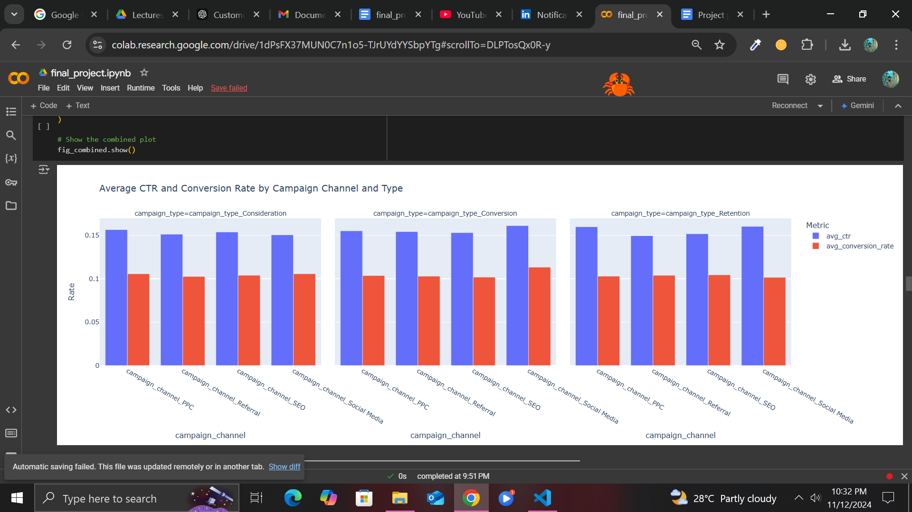
Problem: How effective are different marketing channels and campaigns in driving customer conversion and engagement, as measured by CTR and conversion rate?
Answer: for conversion_through_rate and conversion_rate for both the best campaign_type is Conversion and campaign_channel is Social Media also can be seen at graph.

Slide 9


Important Features and Algorithms used
Important features for predicting conversion were identified using Random Forest Classifier and Gradient Boosting. Six algorithms were applied with hyperparameter tuning using Grid Search method.
Features
🧠Algorithms
Feature Set (X):
Total Page Views
Time on Site
Click-Through Rate
Ad Spend
Conversion Rate
Loyalty Points
Email Activity
Income
Previous Purchases
Social Shares
Age
Target Variable (y):
conversion
Machine Learning Algorithm:
Decision Tree Classifier
Random Forest Classifier
Gradient boosting
SVM (RBF Kernel)
K-Nearest Neighbors
Deep Learning Algorithm:
Neural Network (MLP)

Slide 10
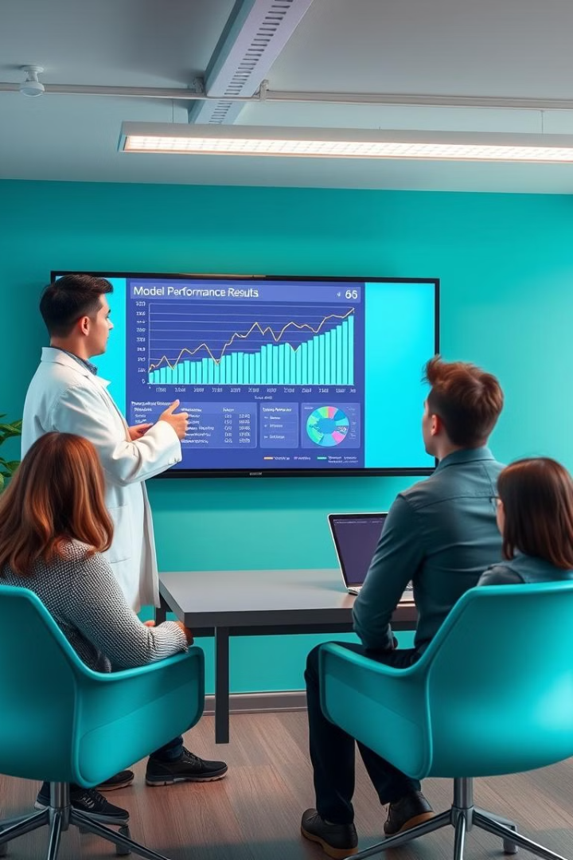
Models Performance
Model | Before Tuning | After Tuning | Improvement
Gradient Boosting | 89.94% | 90.38% | Best Model
Random Forest | 89.31% | 89.19% | Second Best
Decision Tree | 81.06% | 88.50% | Third Best
Neural Network (MLP) | 17.81% | 87.88% | Significant
SVM (RBF Kernel) | 54.69% | 87.88% | Moderate
K-Nearest Neighbors | 62.88% | 87.75% | Moderate

Slide 11

Project Summary and Future Work
The project analyzed customer engagement and loyalty data to predict conversion likelihood and assess marketing channel effectiveness. Future work includes developing a Streamlit-based web app for real-time prediction of and the accuracy increasing using different approaches.

Slide 12


